Slide 1


Slide 2
ANOTHER MILESTONE
A NEW BEGINNING

Slide 3
CORPORATE SPONSORSHIP BY TML DRIVELINES
On 3rd April 2016, Sankalp-A Pledge to Change received assistance for sponsoring tribal children enrolled at its Birsanagar Centre
Distribution of sponsorship worth Rs. 22,500 took place to 21 students
Initially total fee and other expenses for first 6 months of academic year 2016-2017 has been paid to the needy students’ parents
Next instalment will be paid in Oct 2016

Slide 4
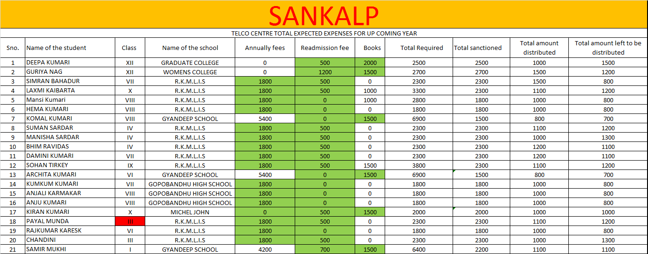
LIST OF BENEFICIARIES

Slide 5
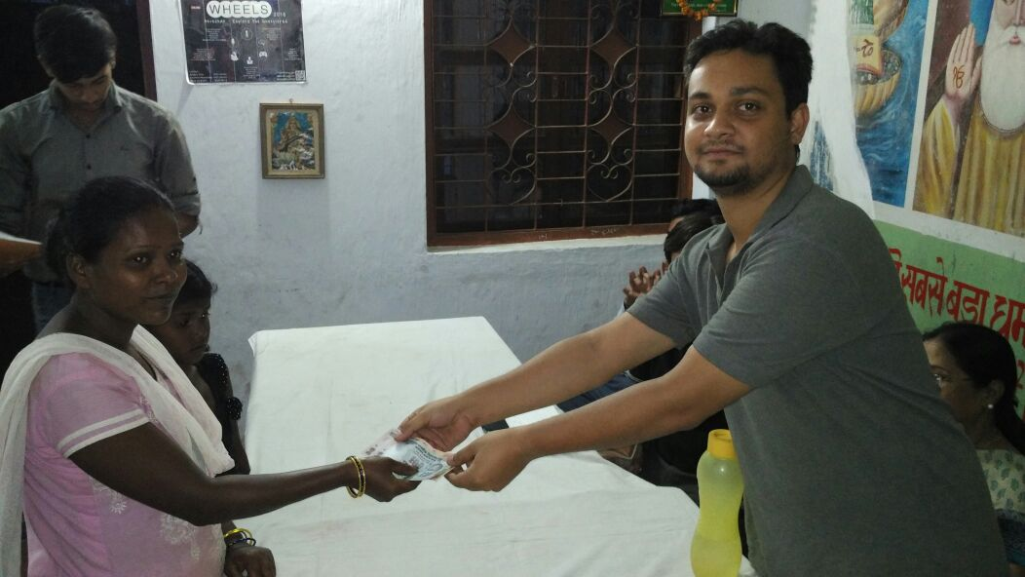
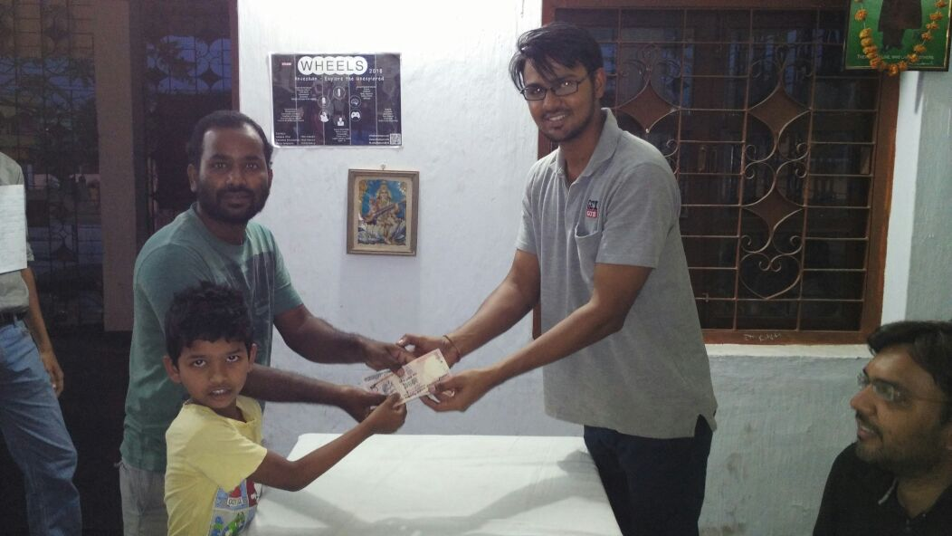
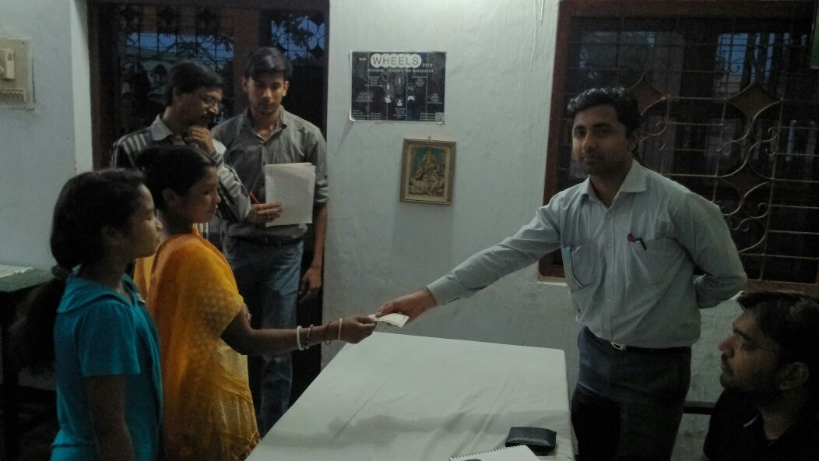
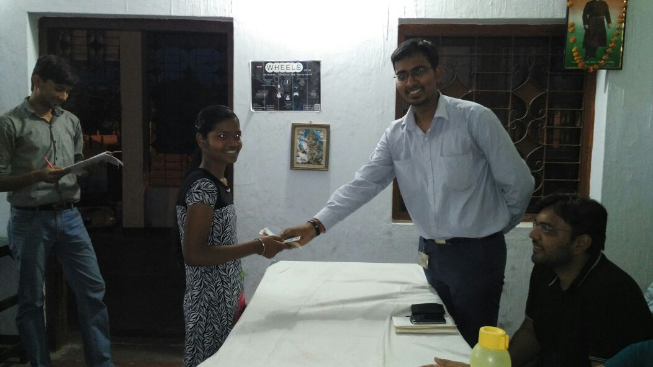

Slide 6
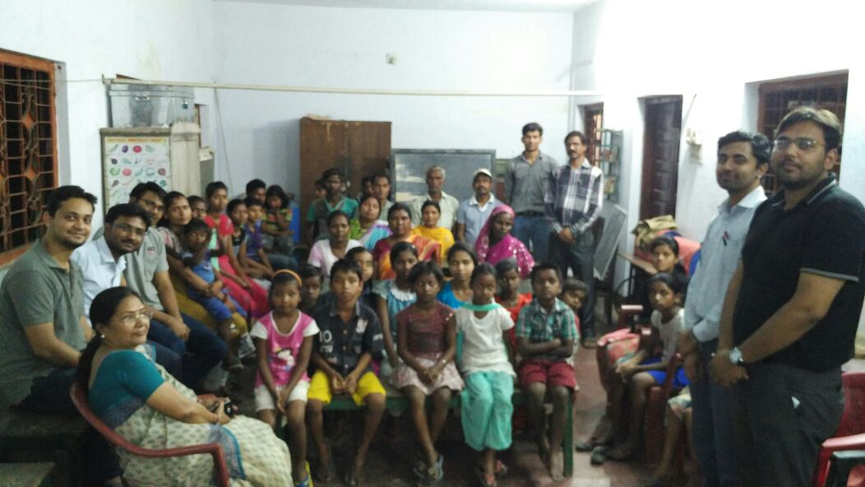
THE TELCO FAMILY

Slide 7
“You have not lived today until you have done something for someone who can never repay you.”
www.sankalpnitjamshedpur.org

